Slide 1
Control Statements
In Python
01 ALSTON ALVARES
Notes:
Entered text
control statements in python
Entered text
break, pass and continue statements in python

Slide 2
Introduction to Control Statements in Python
This presentation provides an overview of control statements in Python and how they can be used to control the flow of a program.
01 ALSTON ALVARES

Slide 3
What are Control Statements?
Control statements are used to alter the flow of a program based on certain conditions.
They allow for better decision making and looping in Python.
There are three main types of control statements in Python: if-else, for, and while.
01 ALSTON ALVARES

Slide 4
If-Else Statements
If-else statements allow you to execute different code blocks based on certain conditions.
The if statement checks a condition and executes a block of code if the condition is true.
The else statement provides an alternate block of code to execute if the condition is false.
01 ALSTON ALVARES

Slide 5
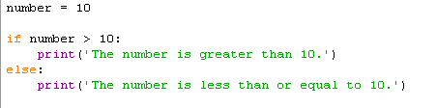
If else example
Code:
Output:
01 ALSTON ALVARES

Slide 6
For Loops
For loops are used to iterate over a sequence of elements.
They allow you to perform a set of actions for each element in the sequence.
You can use the range() function to define the number of iterations.
01 ALSTON ALVARES

Slide 7

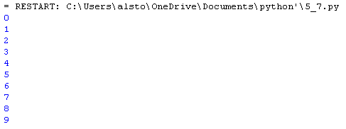
For Loop example
Code:
Output:
01 ALSTON ALVARES

Slide 8
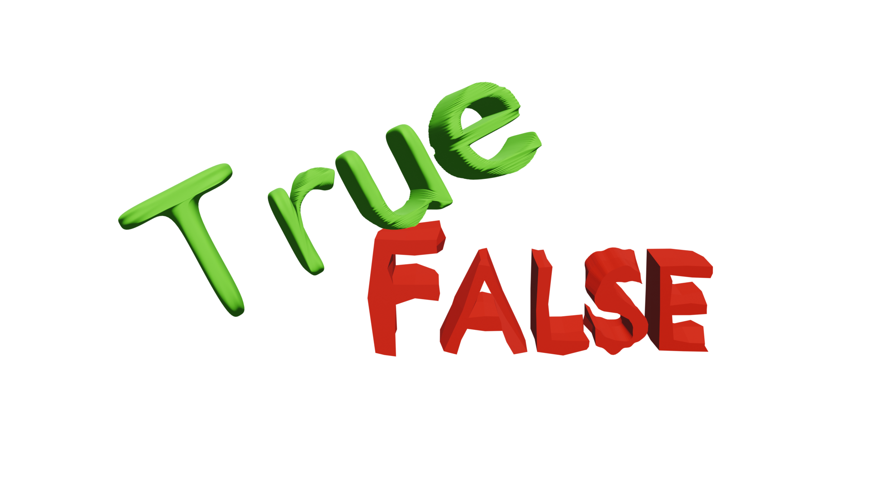
While Loops
Be careful to avoid infinite loops by ensuring the condition eventually becomes false.
While loops continue to execute a block of code as long as a certain condition is true.
They are useful when you don't know the number of iterations in advance.
01 ALSTON ALVARES

Slide 9

While Loop example
Code:
Output:
01 ALSTON ALVARES

Slide 10

Break Statement
The break statement in Python is used to terminate the current loop and resume execution at the next statement immediately after the end of that loop. It can be used in both while and for loops, and if it is inside a nested loop, it will terminate the innermost loop.
01 ALSTON ALVARES

Slide 11

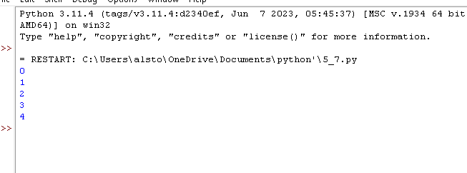
Break statement example
01 ALSTON ALVARES
Code:
Output:

Slide 12

Pass Statement
01
The pass statement can be a useful tool for writing incomplete code
02
It allows you to create a working program even if you haven't yet implemented all of the functionality.
03
The pass statement can also be used as a placeholder for code that you plan to implement later.
01 ALSTON ALVARES

Slide 13
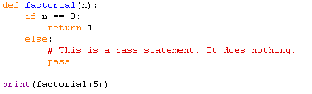

Pass statement example
Code:
Output:
01 ALSTON ALVARES

Slide 14

Continue Statement
The continue statement is used to skip the rest of the current iteration of a loop
This can be useful for cases where you want to process all of the items in a sequence, but you want to skip some of them.
01 ALSTON ALVARES

Slide 15

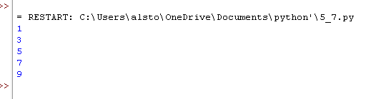
Continue statement example
Code:
Output:
01 ALSTON ALVARES

Slide 16
Topics covered in this presentation.
Control Statements
If-else Statements
For Loops
While Loops
Break Statements
Pass Statements
Continue Statements
01 ALSTON ALVARES

Slide 17
Thank you. Please feel free to ask any questions. 😄
01 ALSTON ALVARES

